Slide 1
HABITAT MONITORING SYSTEM FOR THE MOON AND MARS BASE ANALOG (MAMBA)
Malavika Unnikrishnan
3217581

Slide 2

CONTENTS PAGE
Objective
Lora
Background
Network architecture – Flowchart
Action plan
Flowchart algorithm – Sender node
Flowchart algorithm – Receiver node
Flowchart algorithm – Redundant node
Working model – video
Future studies

Slide 3
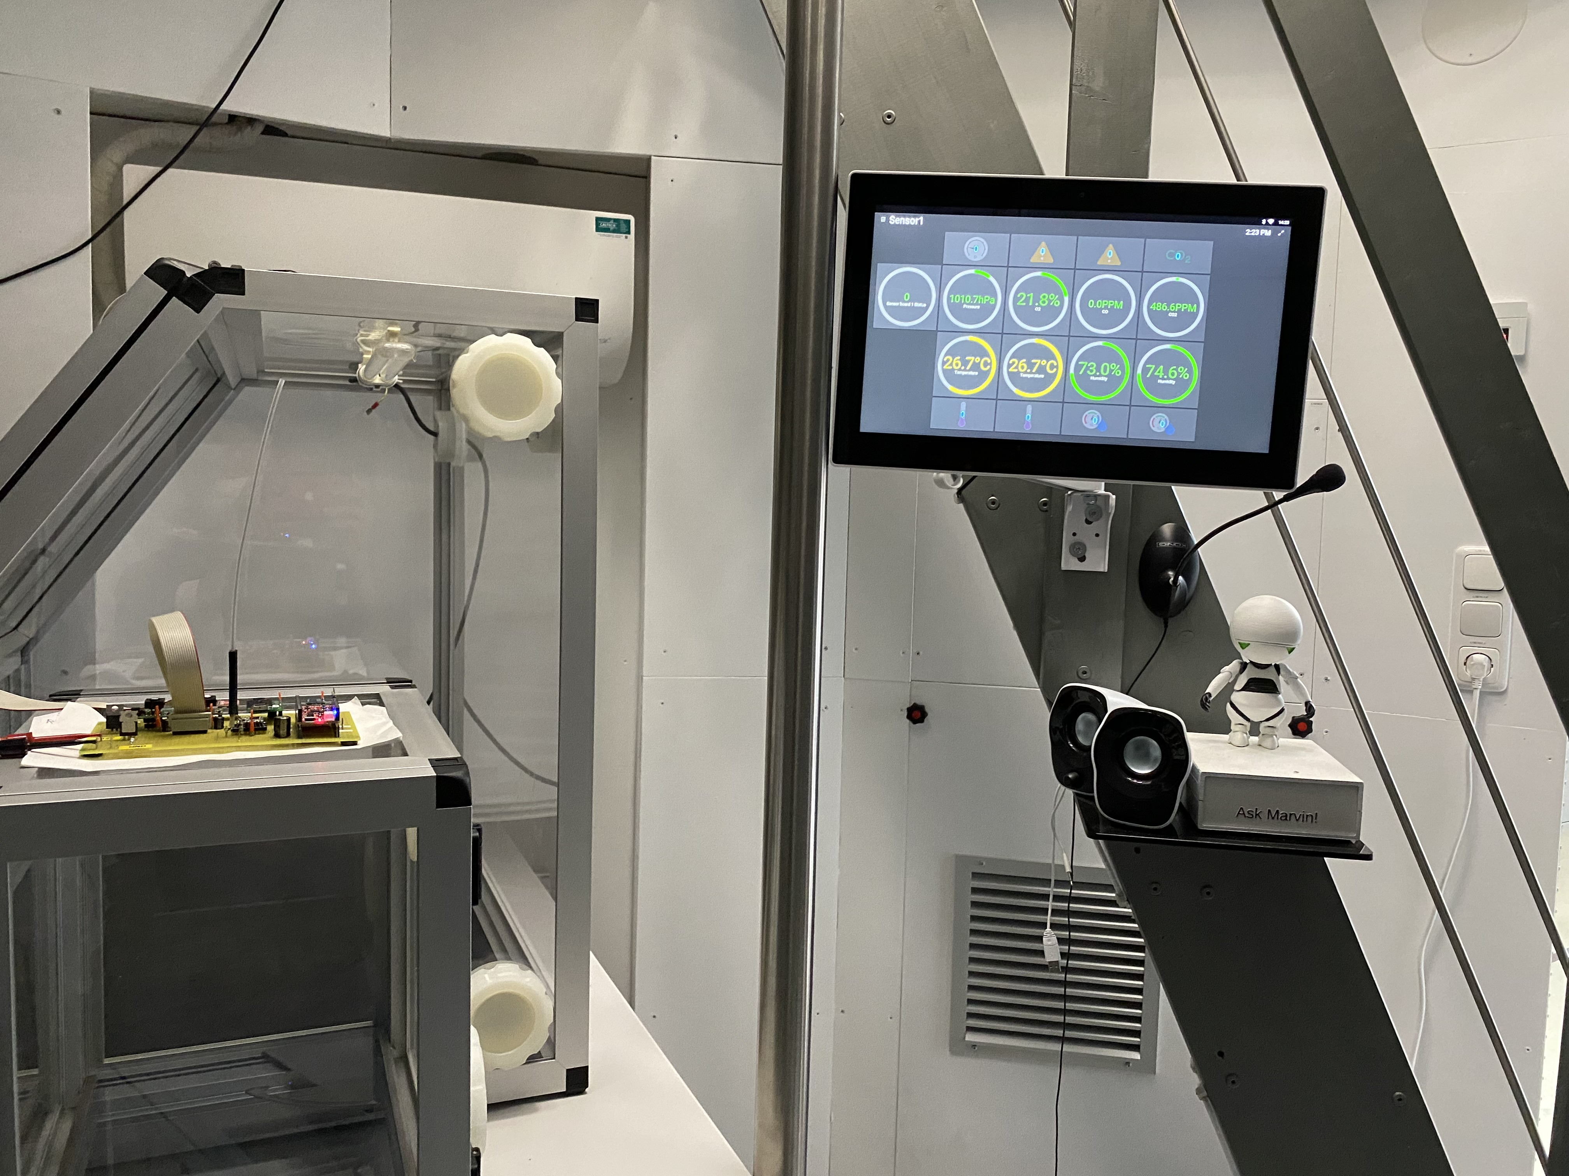
OBJECTIVE
Define and implement a wireless communication architecture for the habitat monitoring of the MAMBA mockup module.
Choose a wireless technology for implementation.
Integrate sensor payloads to existing Mamba infrastructure.
Implement redundancy
Fig 1 : Inside Mamba mockup at ZARM

Slide 4
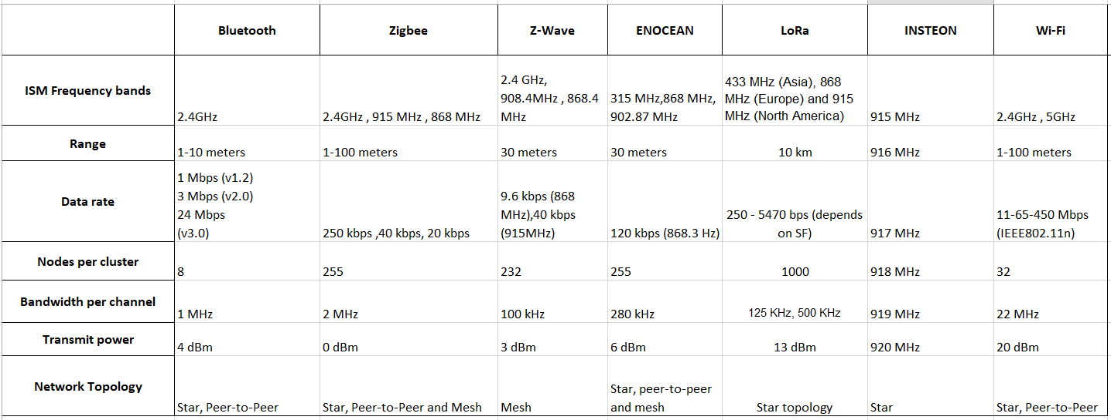
LORA
Advantages of Lora
Lower bandwidth application
Low power requirements
Low cost
Uses 433.05 – 434.79 MHz and 863 – 870 MHz in Europe, 2.4 GHz frequency band unused
Table 1 : Comparison of wireless technologies

Slide 5
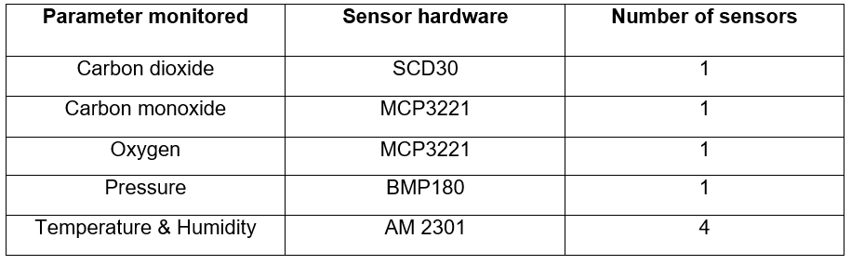
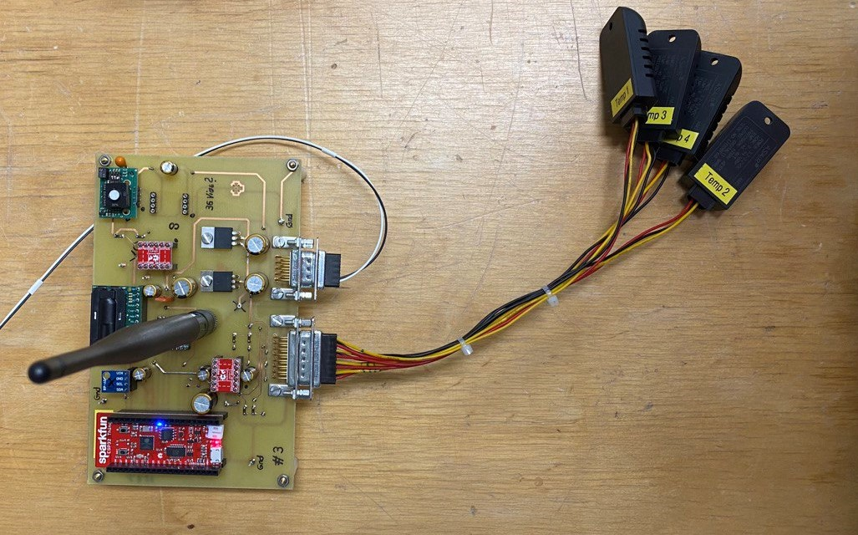
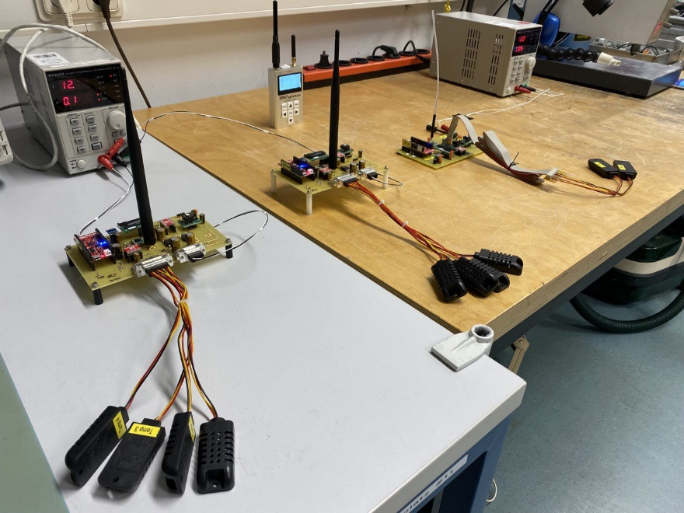
BACKGROUND
The Sender node consists of eight sensors, a microcontroller(ESP32) and lora transceiver(sx1276).
The Mamba Backend consists of Mqtt broker server, Influx database, Grafana application and Openhab tool.
There is also an android tablet inside the mockup on which the sensor payloads are visualized.
Table 2:Sensors used
Fig 2 : Sender nodes

Slide 6
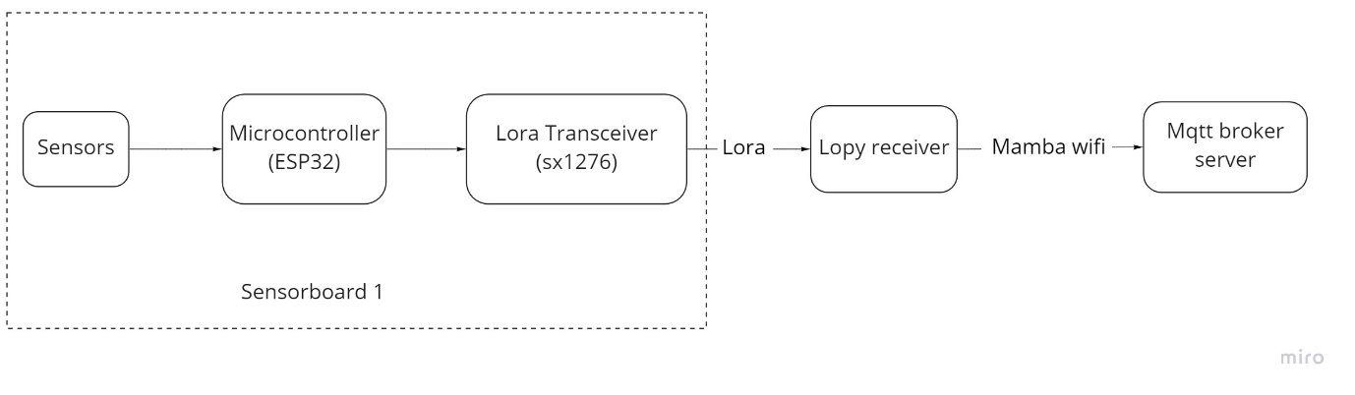
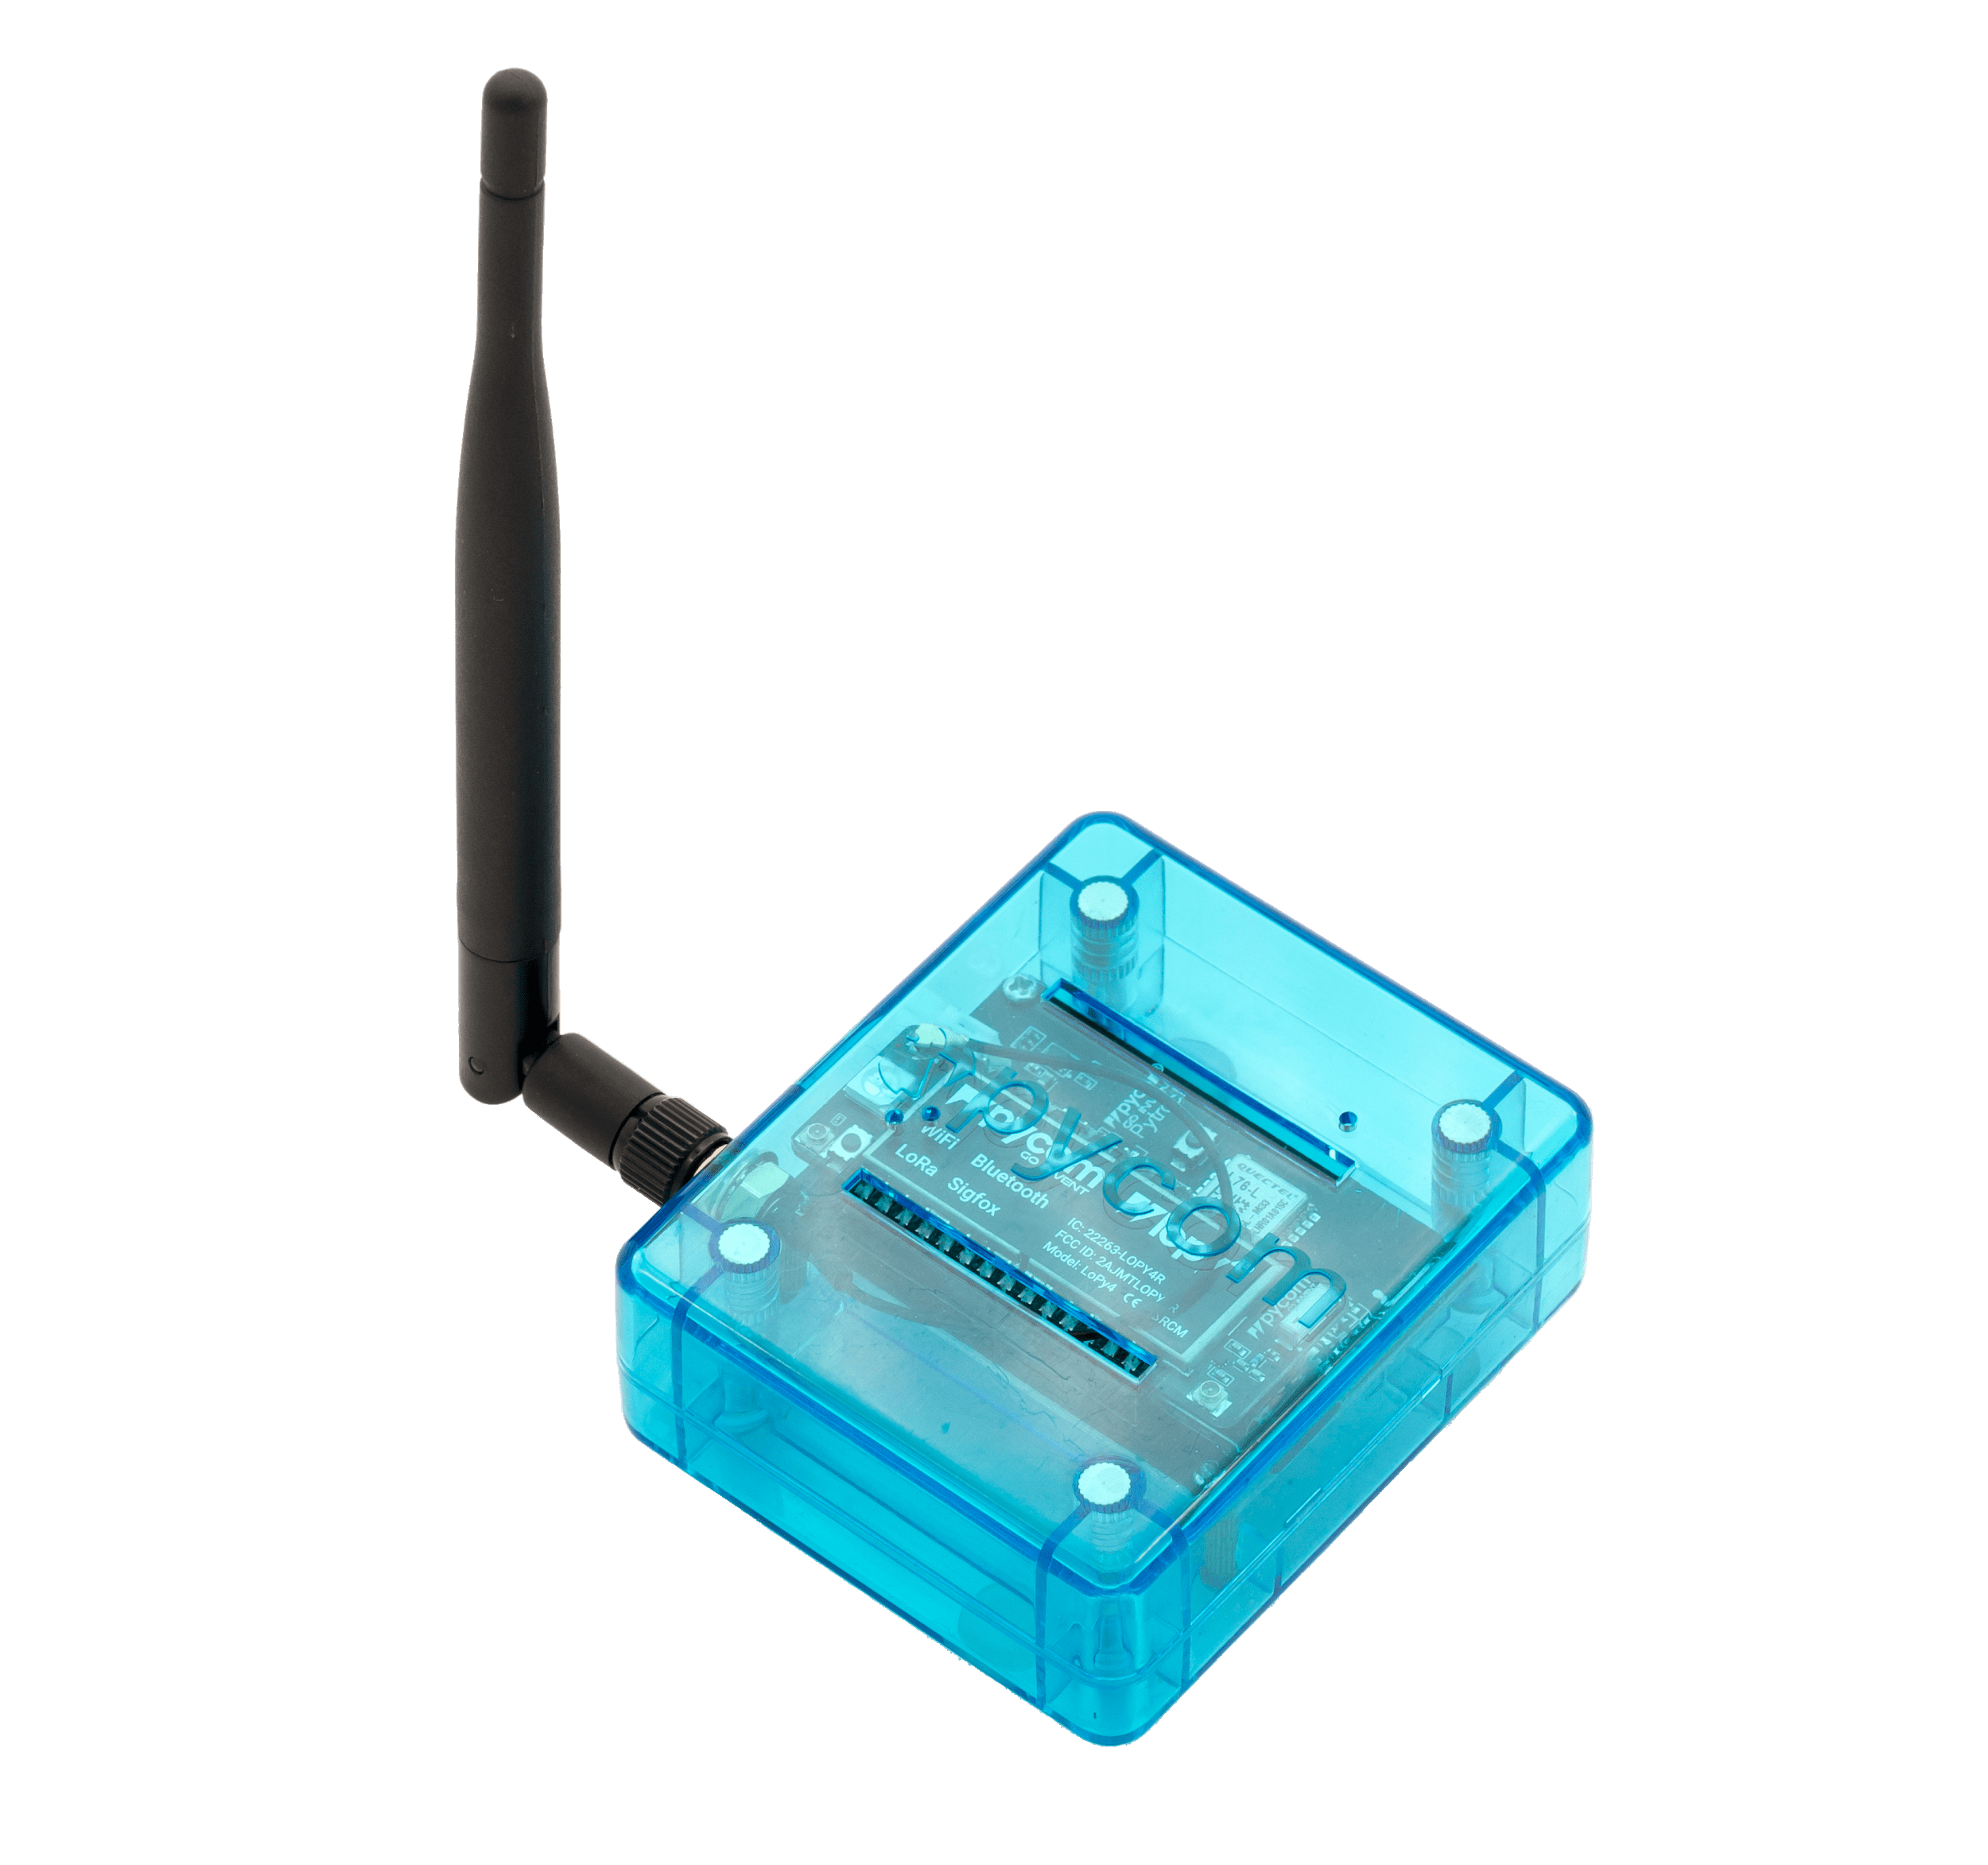
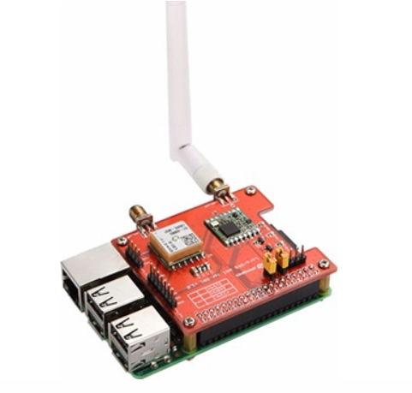
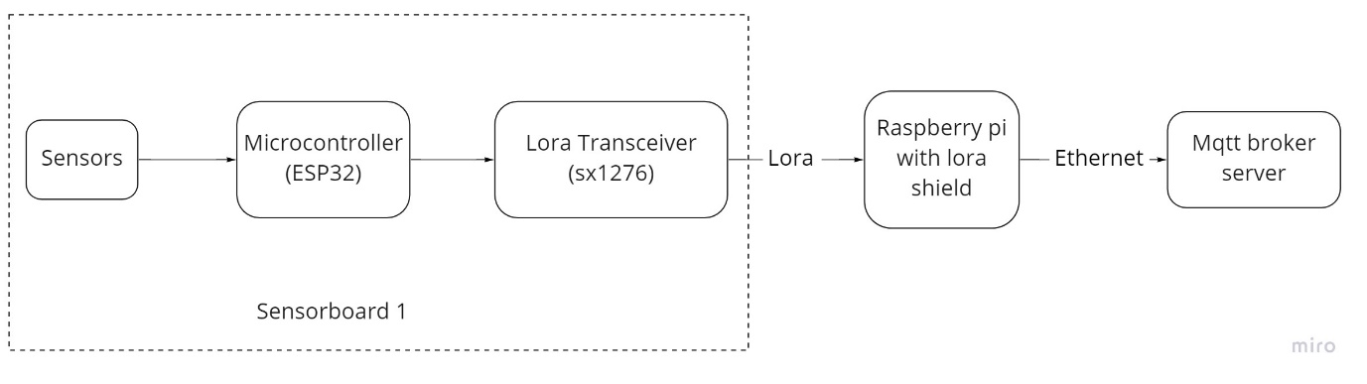
NETWORK ARCHITECTURE – FLOWCHART
Fig 3 : Lora receiver (Pycom device)
Flowchart 1 : Network architecture for initial phase of the project
Fig 4 : Raspberry pi with lora shield
Flowchart 2: Network architecture for final phase of the project

Slide 7
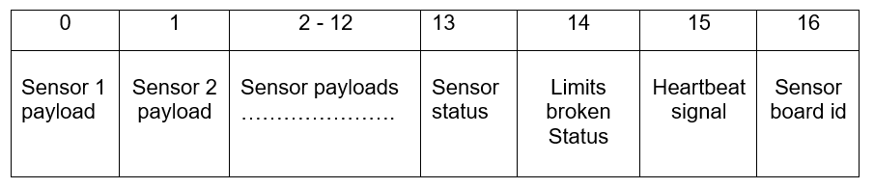

ACTION PLAN
Establishing communication between the sender node and a lora receiver (pycom lopy device)
Establishing connection between lora receiver and mqtt broker server using the Mamba Wi-Fi
Take sensor readings continuously and pack them before transmitting
Checking health condition of sensors
Setting Threshold limits for “safe habitat conditions”
Frequency of sending sensor payloads and heartbeats
Account for packet loss - Acknowledgements
Redundancy check
Remove Wi-Fi dependency
Fig 5 : Sensor payload packet
co2, co, o2, Pressure, Temp(4), Humidity(4)

Slide 8
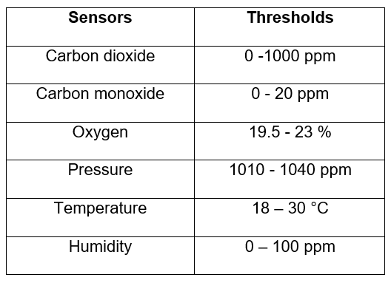
ACTION PLAN – Sensor health status, Threshold limits & Sensor board id
Sensor health status(13)
The health condition (working/broken) of each sensors are set in the form of 0 and 1 respectively
Sensor condition status transmitted with sensor payloads
Binary representation of 192 = 11000000
Threshold limits status(14)
Checks if the sensor payloads are within the threshold limits
Sender board id(16)
The three sender nodes are assigned sensor board ids 1,2 and 3
Redundancy check
Three sensor boards per module – two primary sender nodes one at the lower deck and on at the upper deck
The third sender node acts as the redundant node
The redundant board replaces the primary sender node at the lower deck if it malfunctions.
All sets of payloads received by the receiver node updated to the MQTT broker server
Table 3 : Set threshold limits

Slide 9
ACTION PLAN – Redundancy check & Frequency of message sent
Frequency of message sent
All sender nodes sends sensor payloads immediately if threshold limits are broken
All sender nodes sends heartbeat signal every 3.5 seconds
Primary sender node sends payloads every 30 seconds, if within threshold limits
Redundant node sends payloads every 2 minutes, if within threshold limits
Acknowledgements
Acknowledgements sent by receiver node
Sensor payloads updated every 30 seconds to queue at sender node
Only when acknowledgements received for each packet, the packet is pushed out of the queue
Ethernet connection
Replace lopy pycom receiver boards with Ethernet enabled Raspberry pi and lora shield

Slide 10
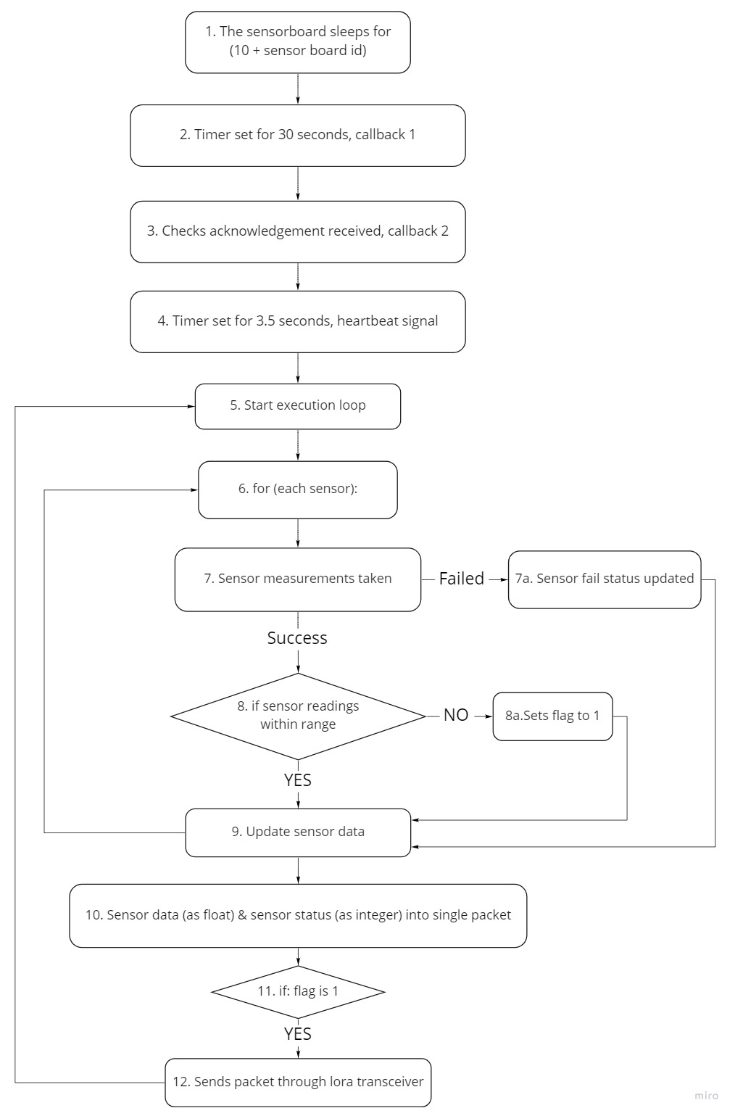
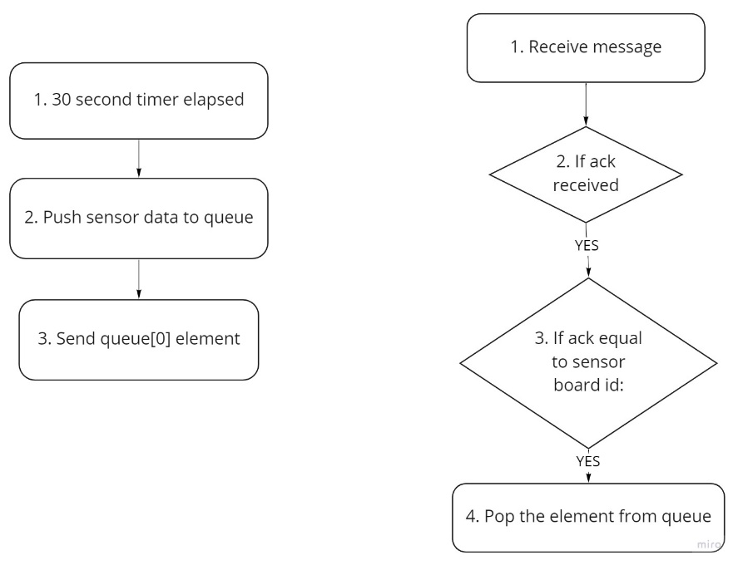
FLOWCHART ALGORITHM – PRIMARY SENDER NODE
Flowchart 4 :Callback 1(left) & 2(right) from Flowchart 3
Flowchart 3 : Primary sender node algorithm

Slide 11
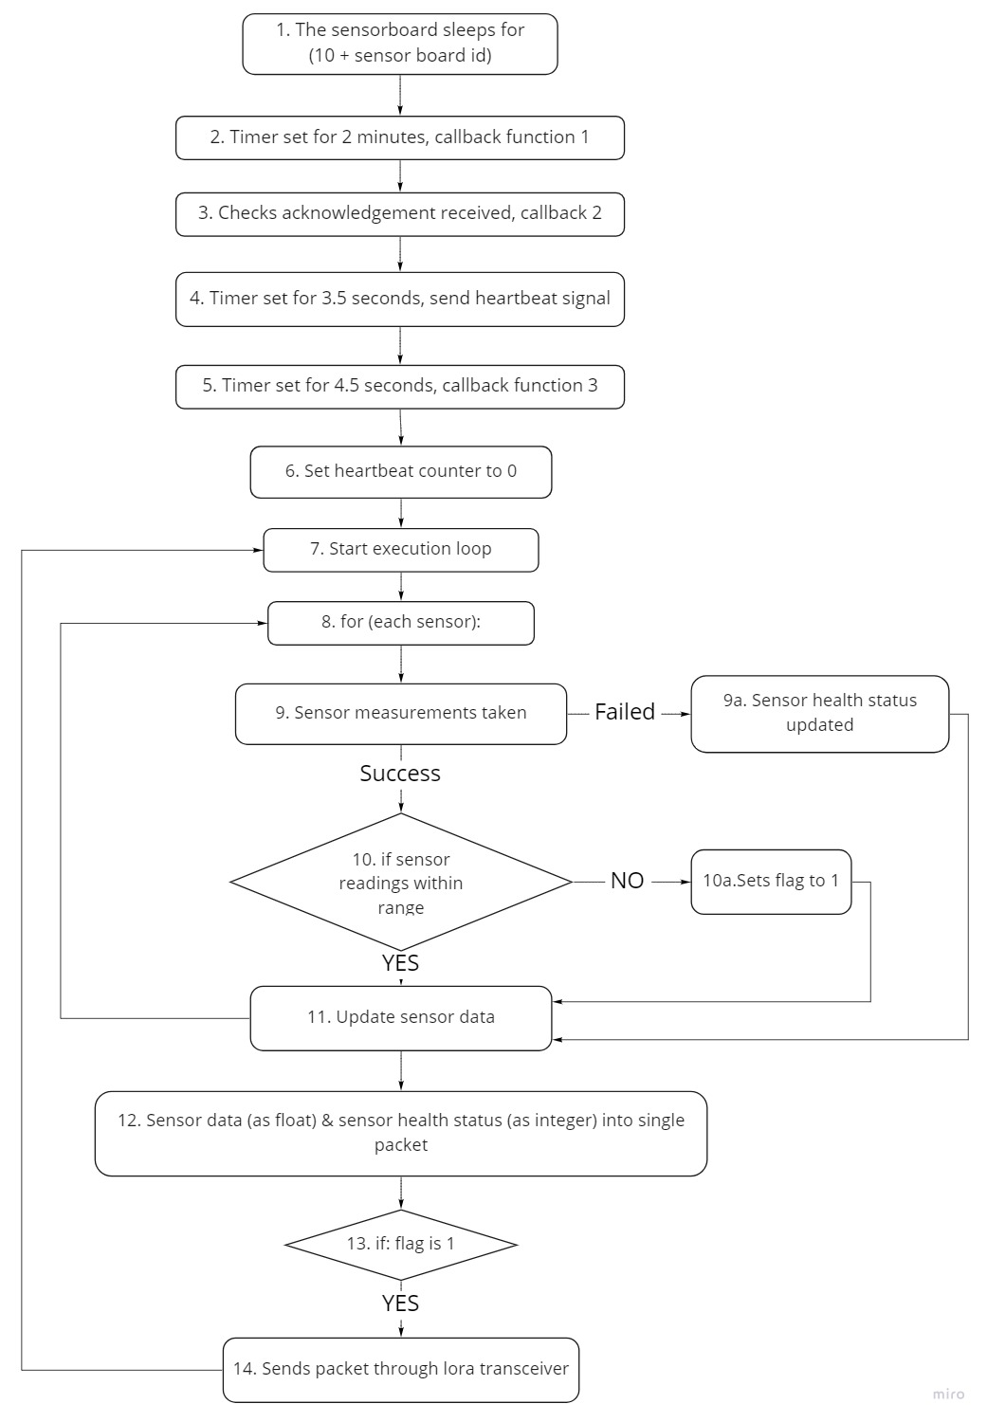
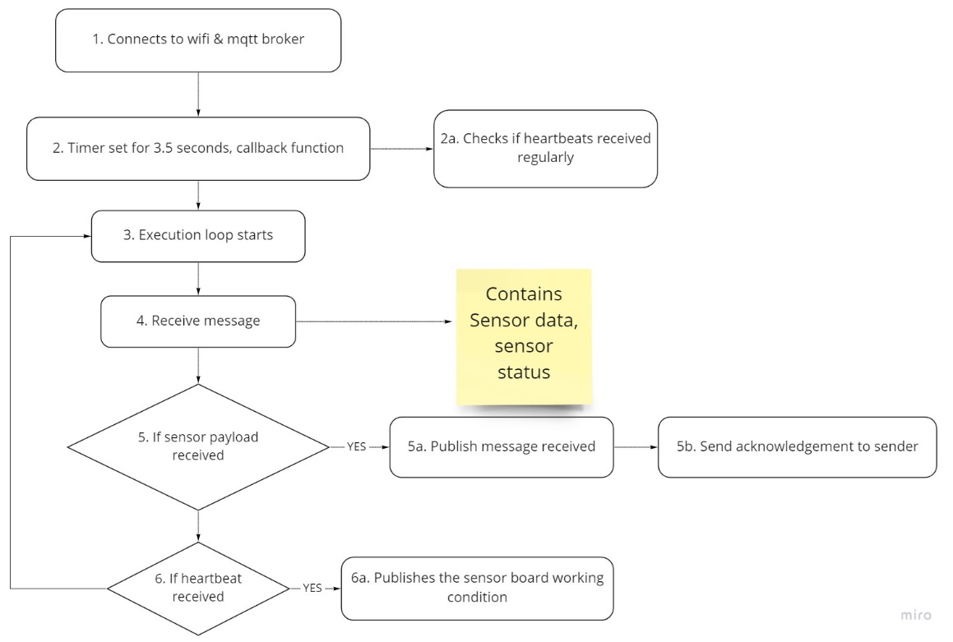
FLOWCHART ALGORITHM – REDUNDANT SENDER NODE & RECEIVER NODE
Flowchart 4 : Receiver algorithm
Flowchart 5 : Redundant node algorithm

Slide 12
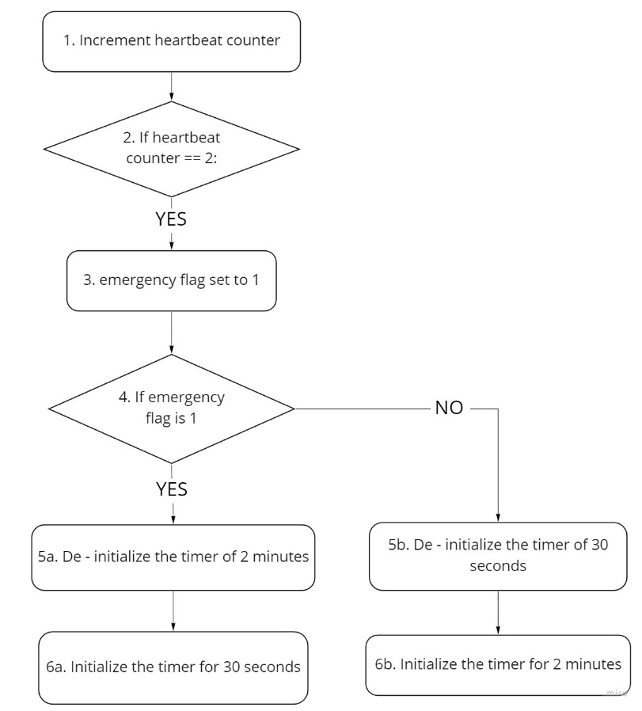
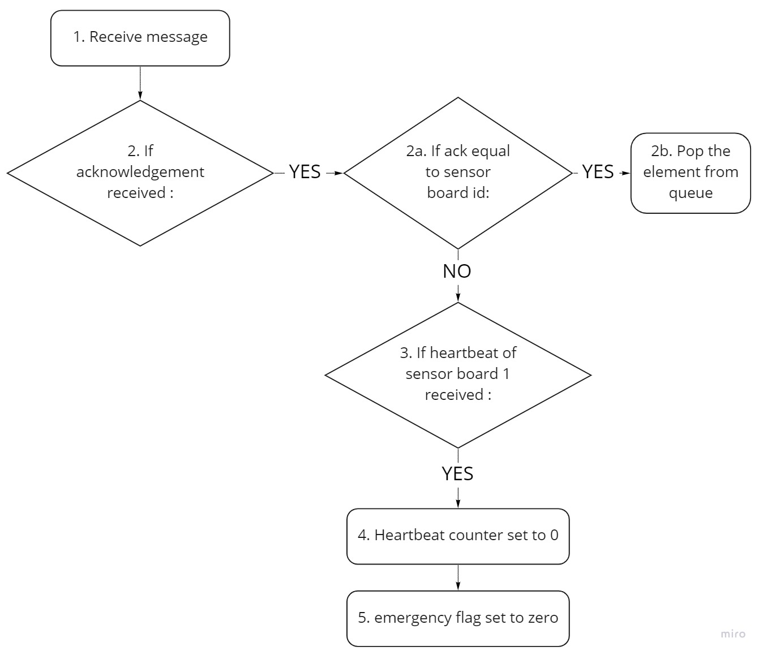
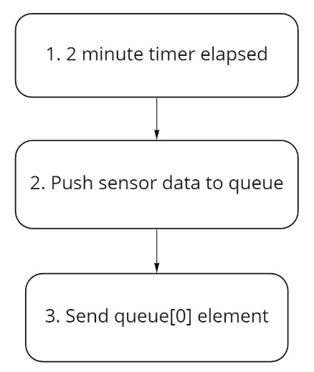
FLOWCHART ALGORITHM – REDUNDANT SENDER NODE
Flowchart 6 : Callback 1 of Redundant node
Flowchart 7 : Callback 2 of Redundant node
Flowchart 8 : Callback 3 of Redundant node

Slide 13
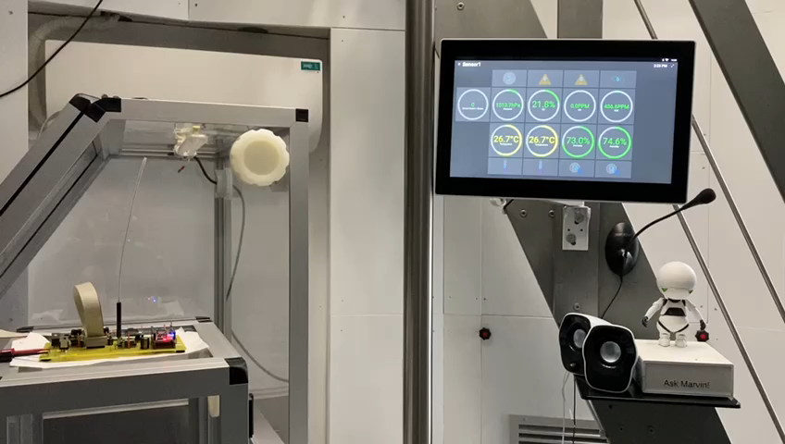
WORKING MODEL VIDEO – Co2 threshold levels broken condition
Video 1 : Co2 threshold levels broken condition

Slide 14
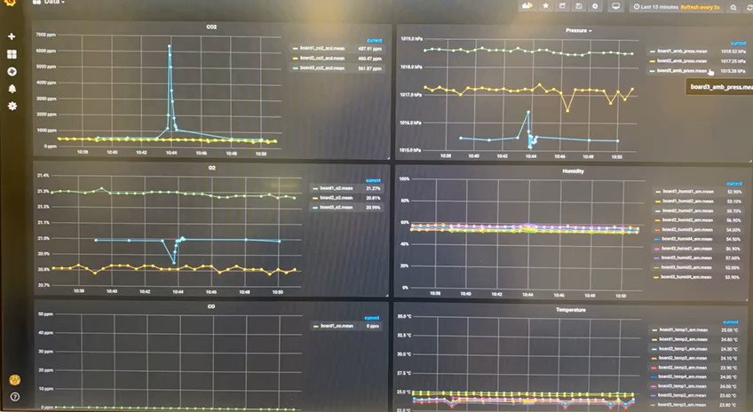
WORKING MODEL VIDEO – Co2 threshold levels broken condition
Video 2 : Co2 threshold levels broken condition (Grafana)
Primary Board 1
Redundant Board
Primary Board 2

Slide 15
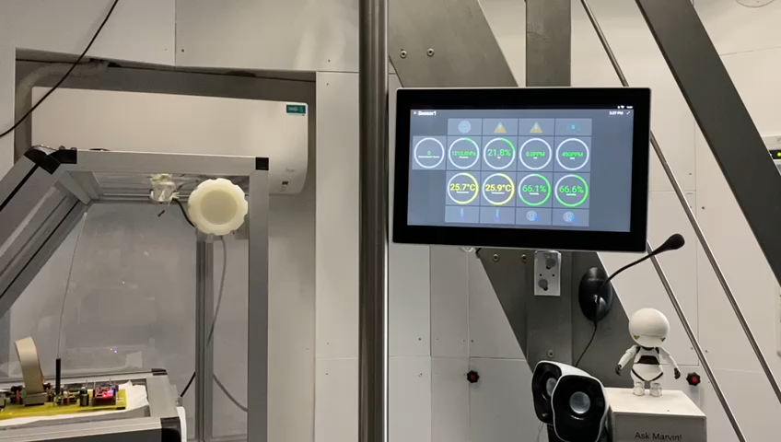
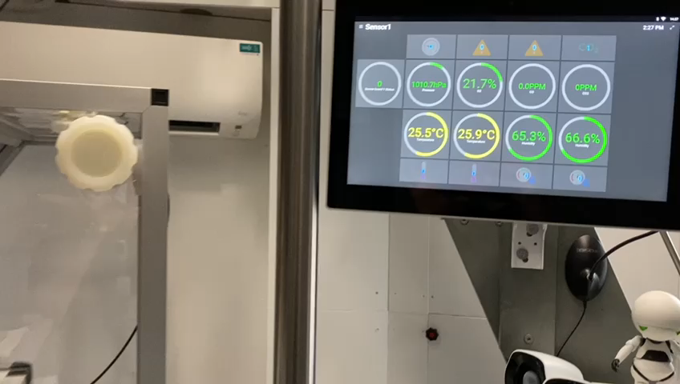
WORKING MODEL VIDEO – Co2 sensor fail condition
Video 3 : Co2 sensor fail condition

Slide 16
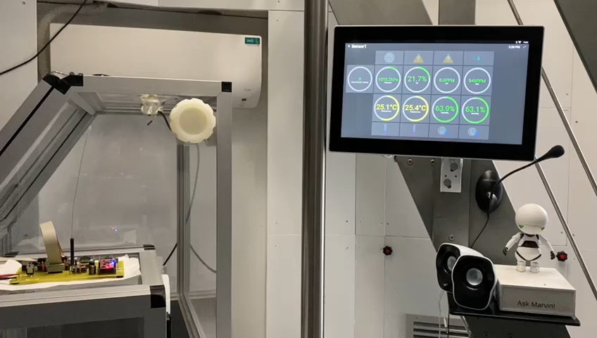
WORKING MODEL VIDEO – Lora fail condition
Video 4 : Lora fail condition

Slide 17
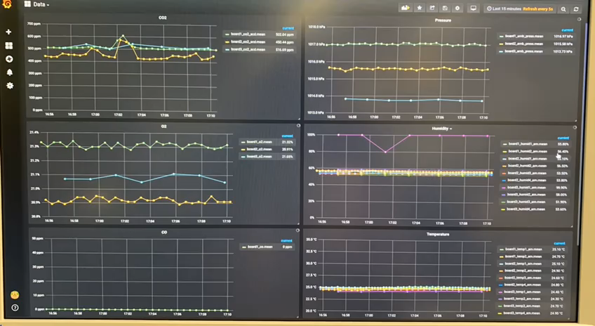
WORKING MODEL VIDEO – Redundancy check
Video 5: Redundancy functionality working (Grafana)
Primary Board 1
Redundant Board
Primary Board 2

Slide 18
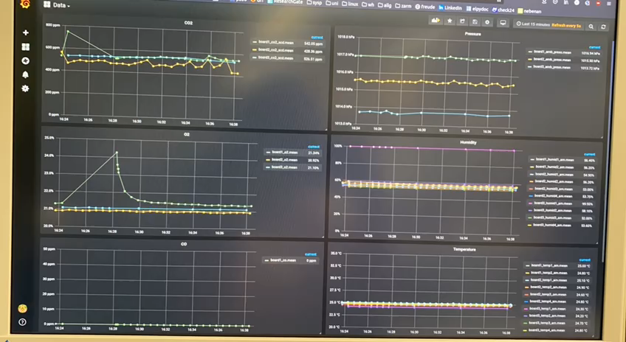
WORKING MODEL VIDEO – Redundancy check
Video 5: Redundancy functionality working (Grafana)
Primary Board 1
Redundant Board
Primary Board 2

Slide 19
FUTURE STUDIES
Improving the packet loss rates
Power consumption and data transmission rate analysis
Improving the data visualization tools inside the mockup

Slide 20
THANK YOU

